Slide 1

Bitstamp Performance Overview
Daily Report

Slide 2


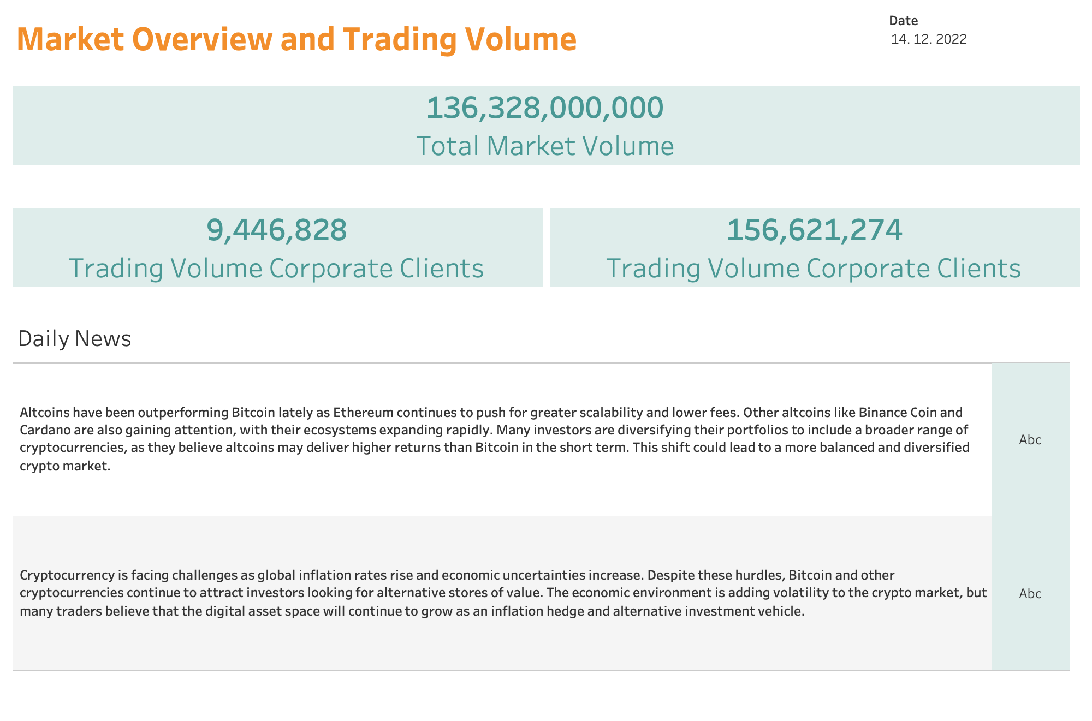

Slide 3
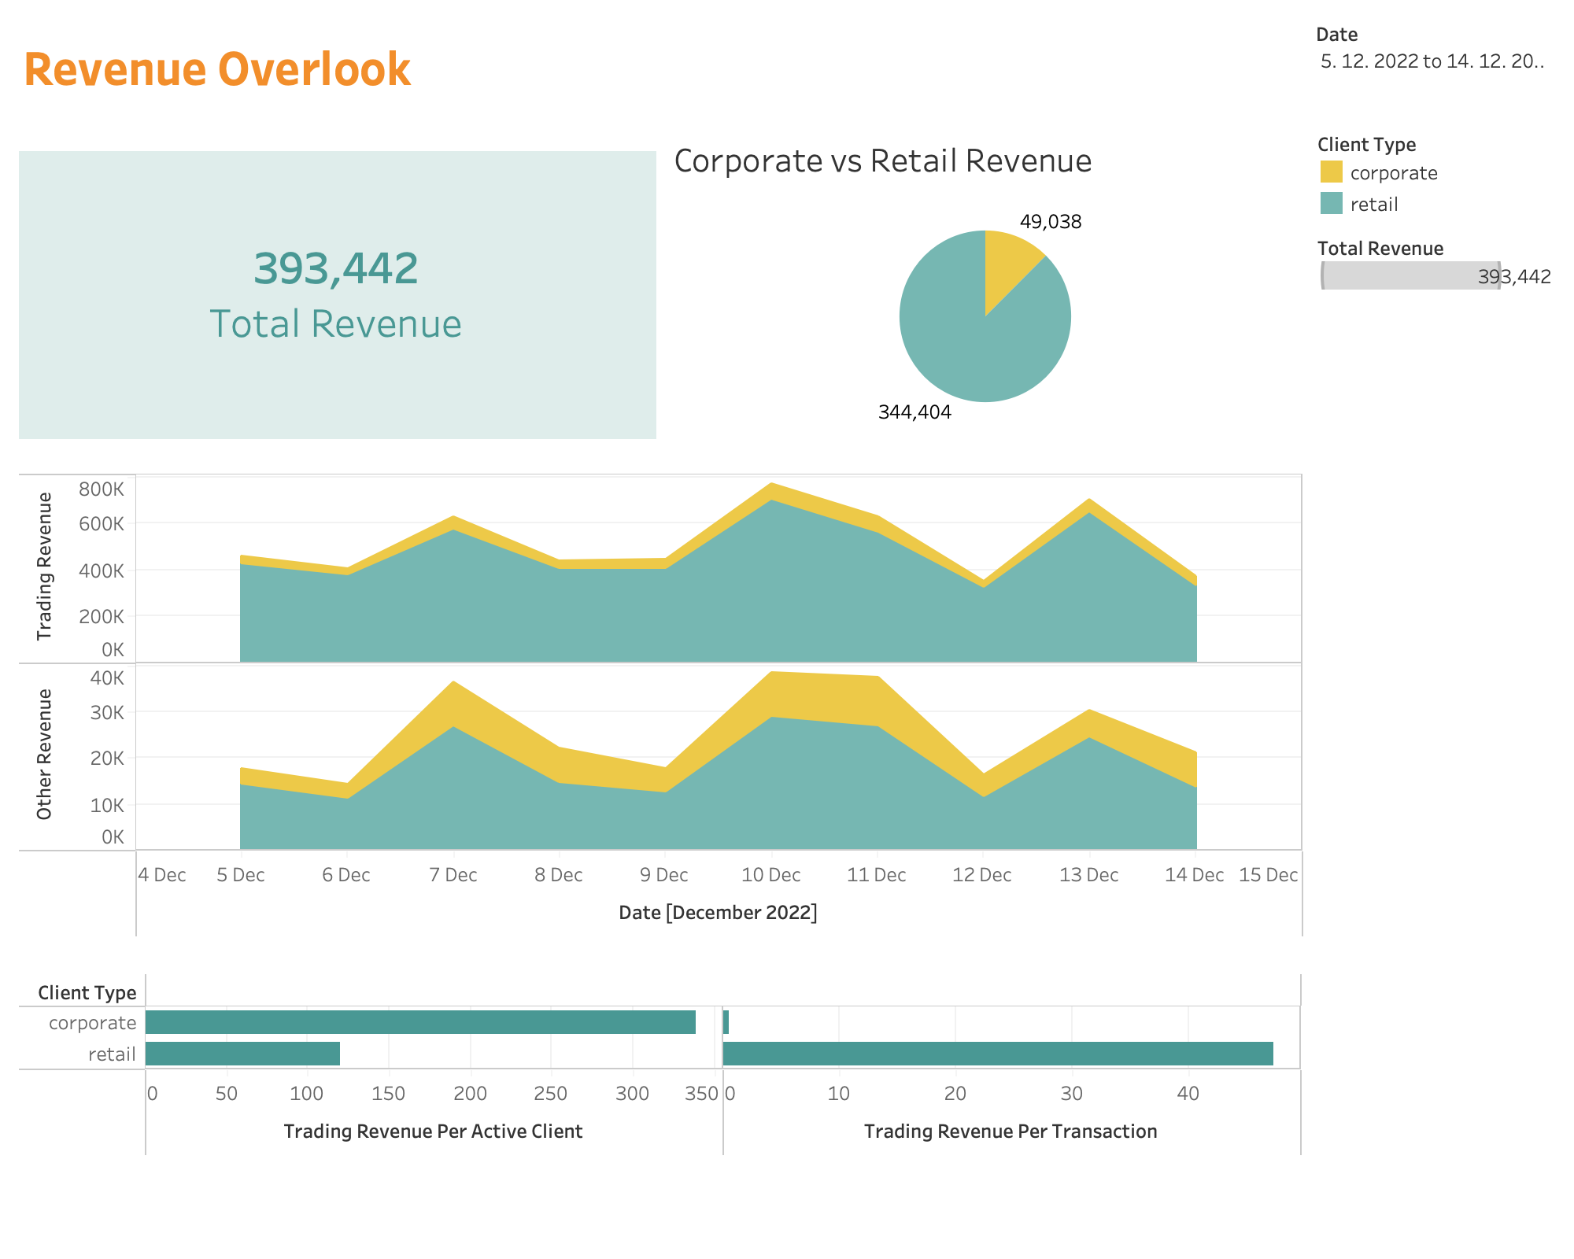

Slide 4
